Slide 1

NEURAL STYLE TRANSFER
OF
ASIAN PAINTING
Boon Jun

Slide 2



PROBLEMS?
Long Duration Manual Work
Talent Dependent
Highly Competitive

Slide 3
MAKE DIGITAL CONTENT GENERATION EASY
FOR
DESIGN COMPANY

Slide 4
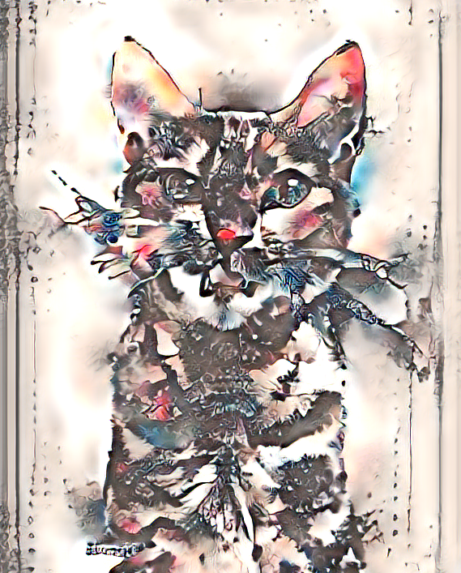
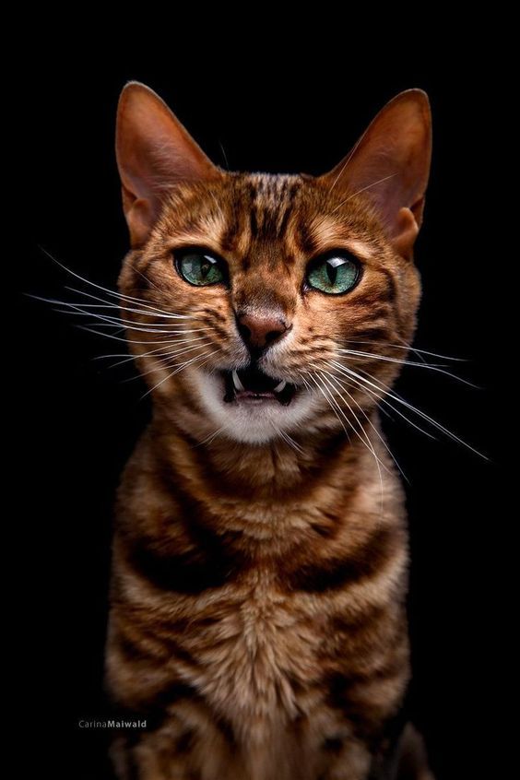
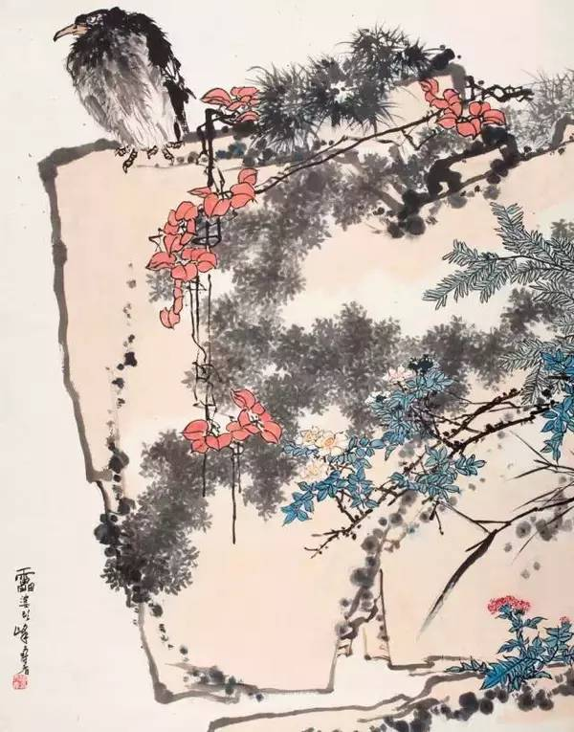
HOW?
+
=
WITH Convolutional Neural Network

Slide 5
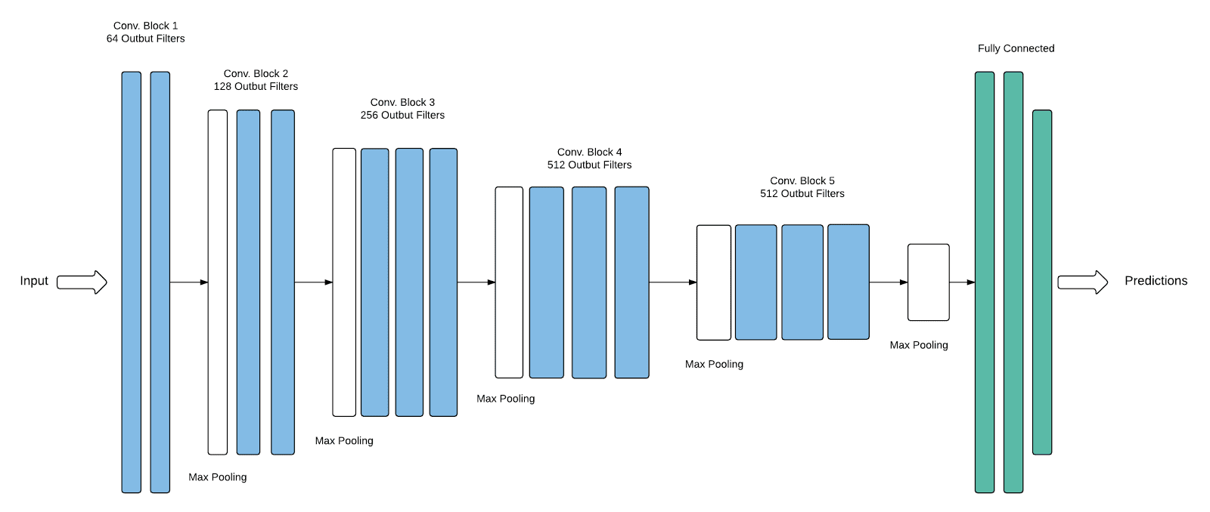
HOW?
VVG19
Trained to extract different image features on it owns

Slide 6
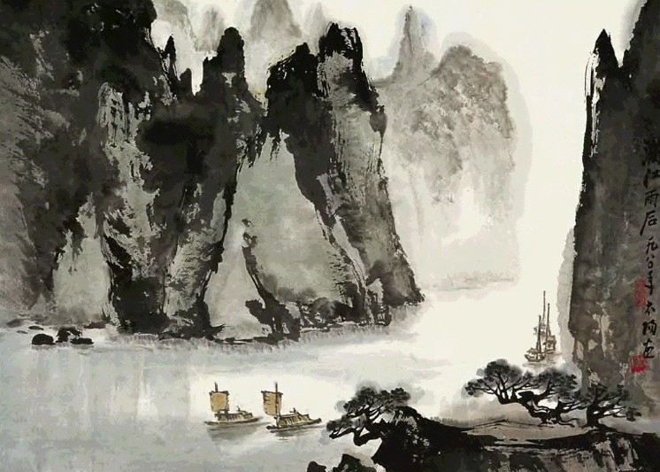
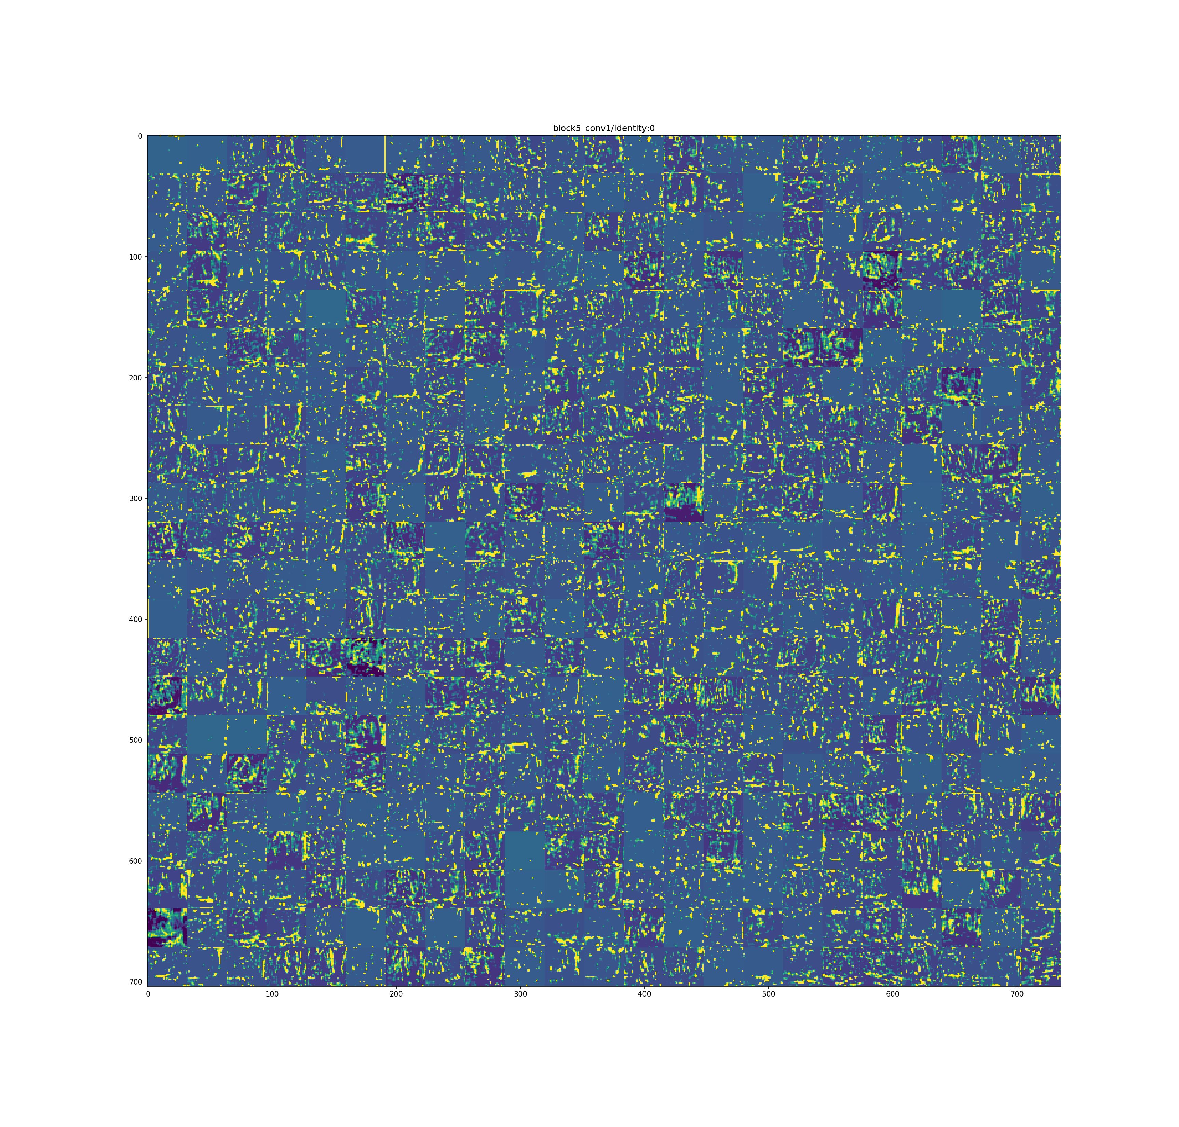
HOW?
Layer 1
Layer 5

Slide 7



3 NEURAL STYLE TRANSFER (NST) MODELS
Model 1
Original NST
Model 1
Original NST
Model 2
Transfer Learning
Model 2
Transfer Learning
Model 3
Autoencoder + WCT
Model 3
Autoencoder + WCT

Slide 8



MODEL 2
Dataset
100 Chinese Painting
8 categories
Augmentation
944 paintings
Avg 100/categories
Transfer Learning
Training accuracy: 0.99
Validation accuracy: 0.93

Slide 9
EVALUATION
Based on 37 votes from google form

Slide 10
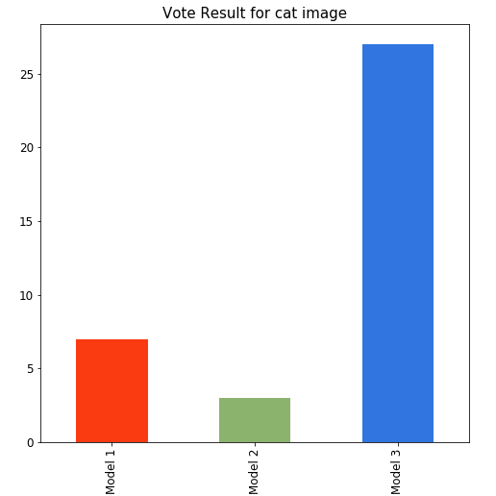
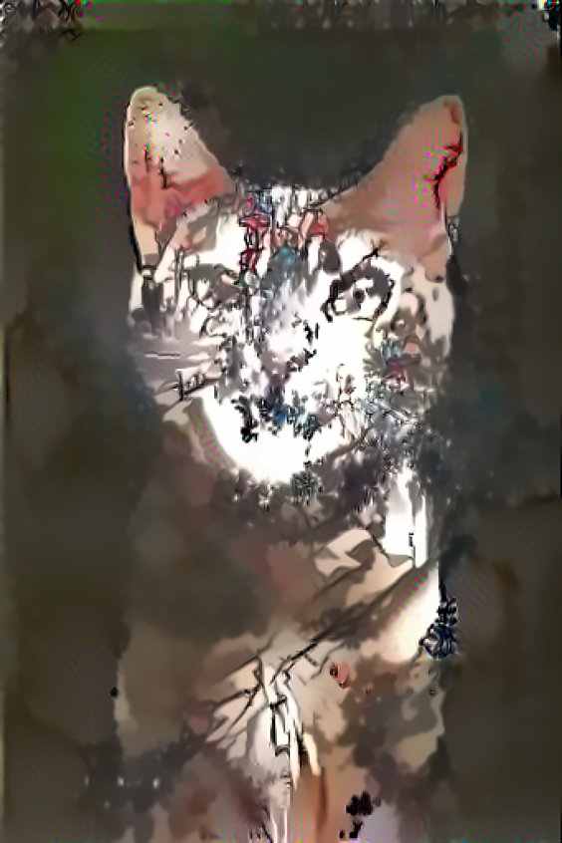
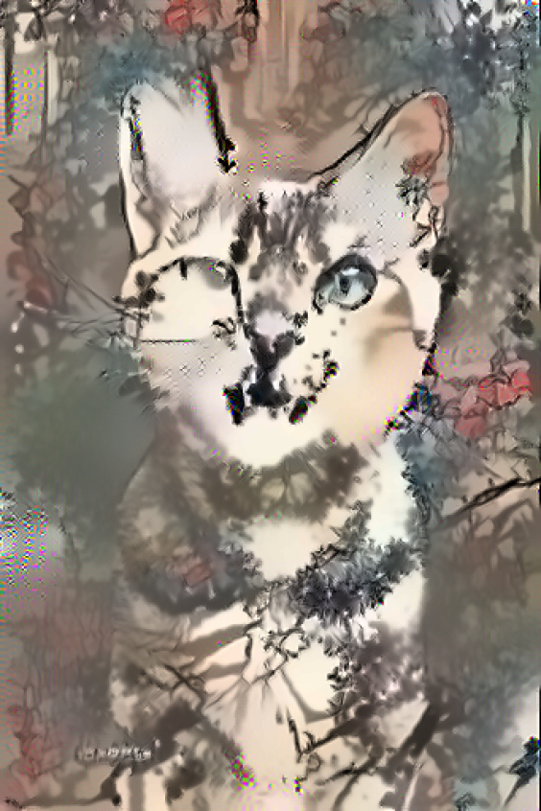
EVALUATION
Content Image
Style Image
Model 1
Model 2
Model 3
0
0
1

Slide 11
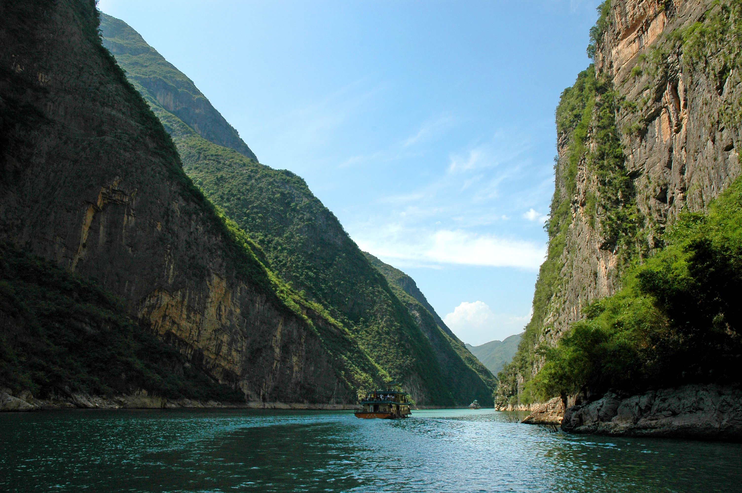
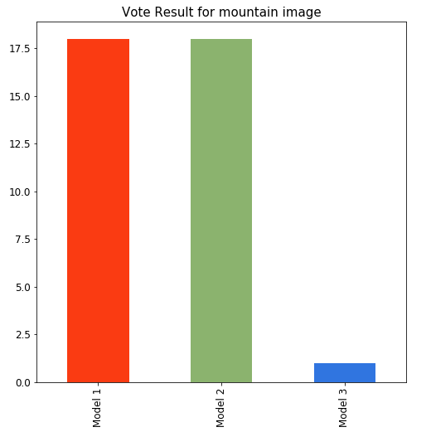
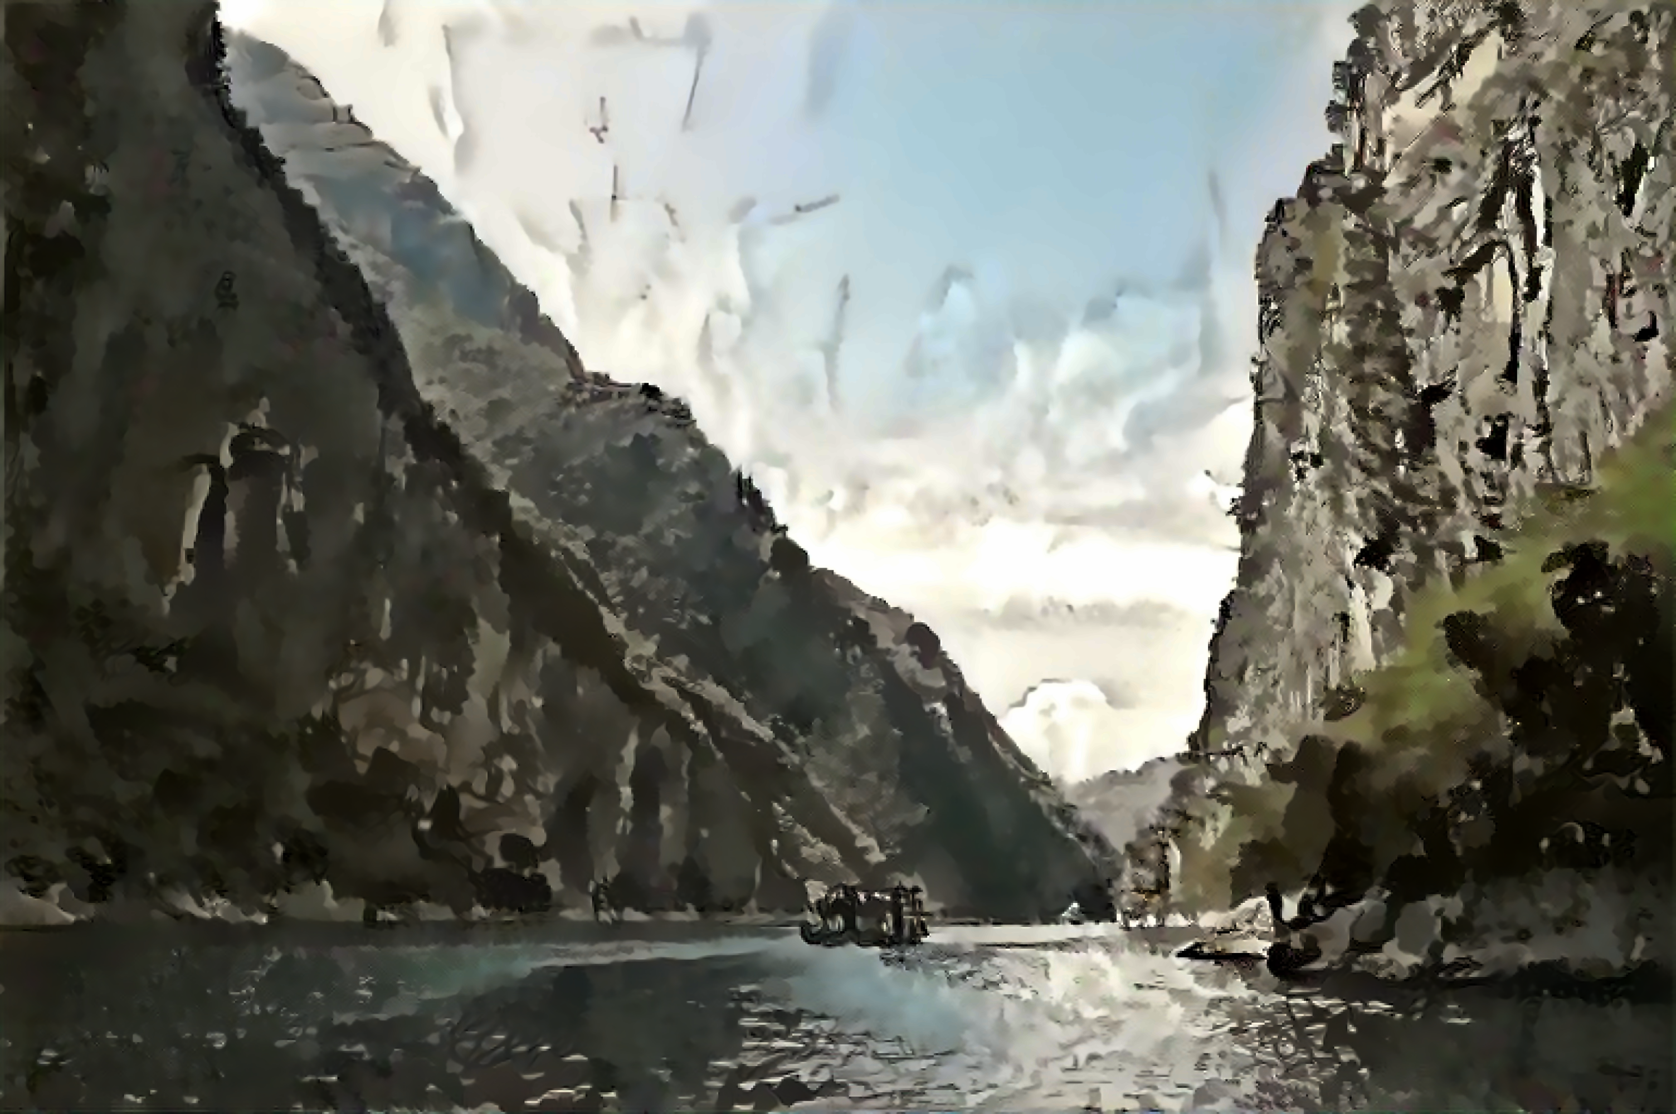
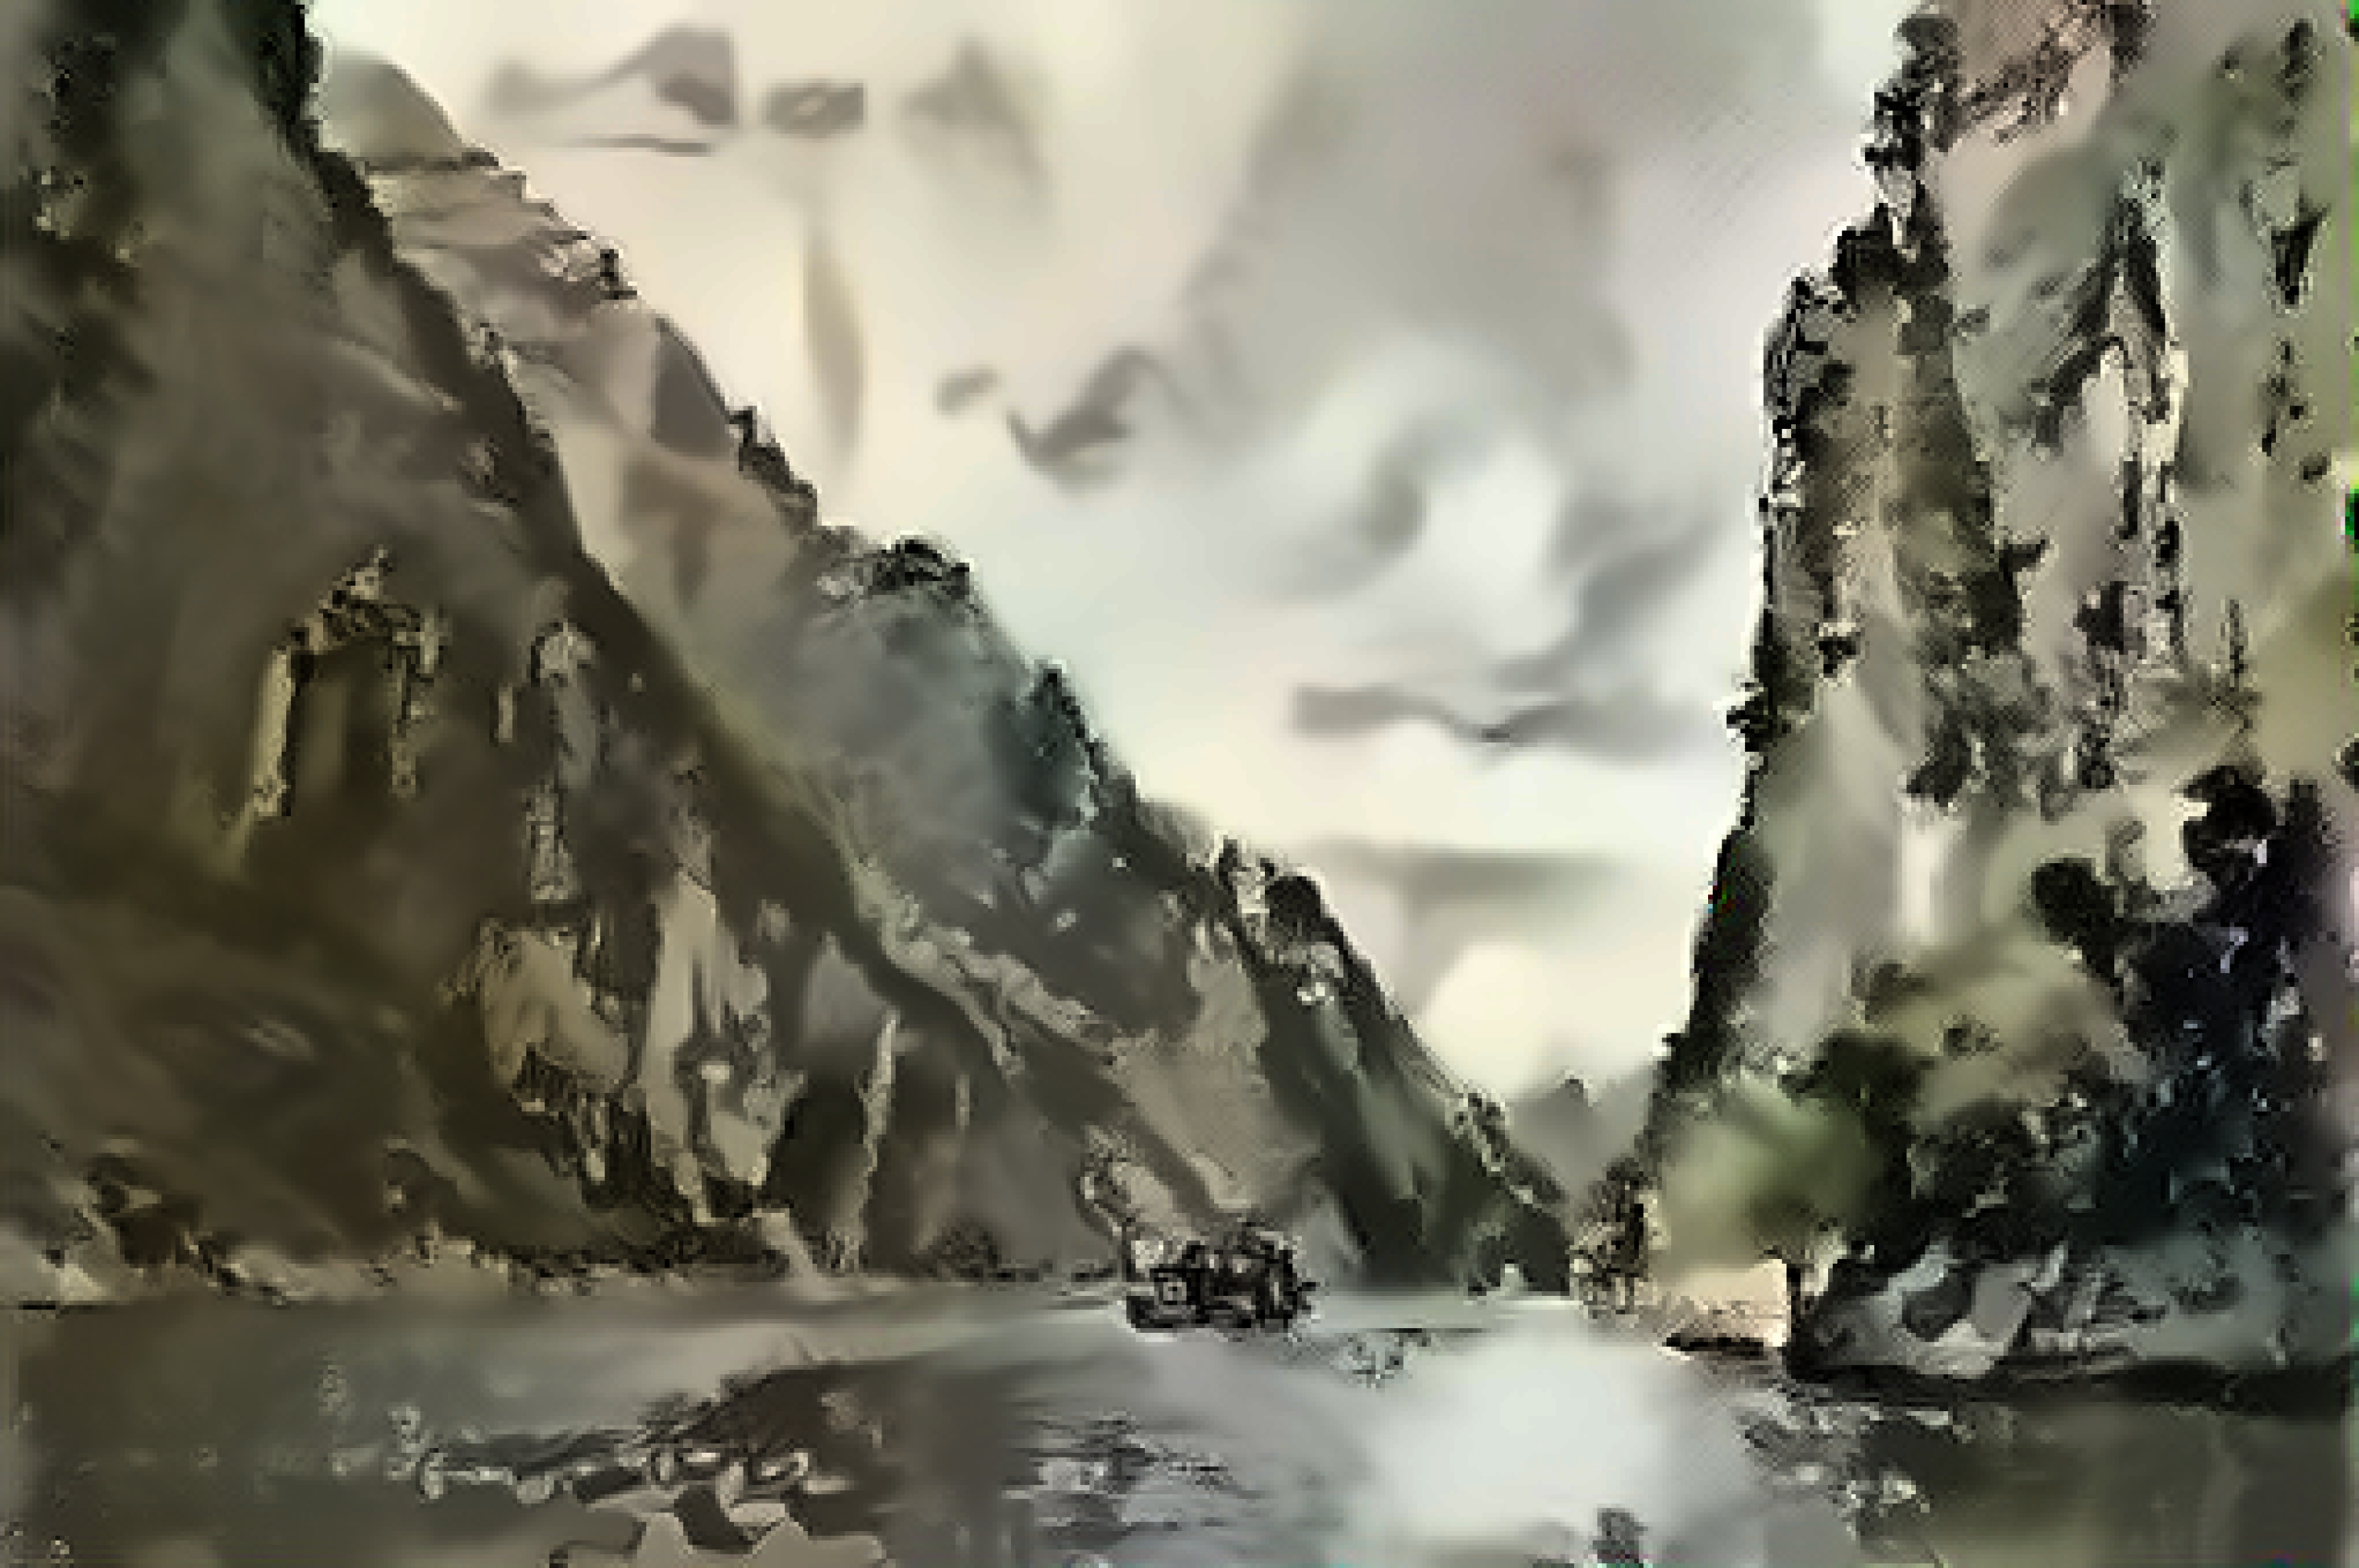
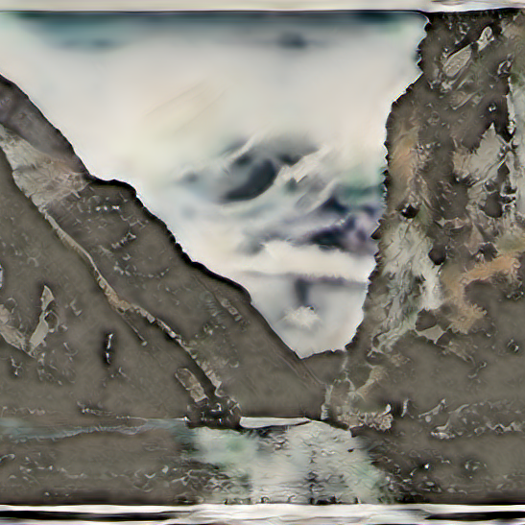
EVALUATION
Content Image
Style Image
Model 1
Model 2
Model 3
1
1
1

Slide 12
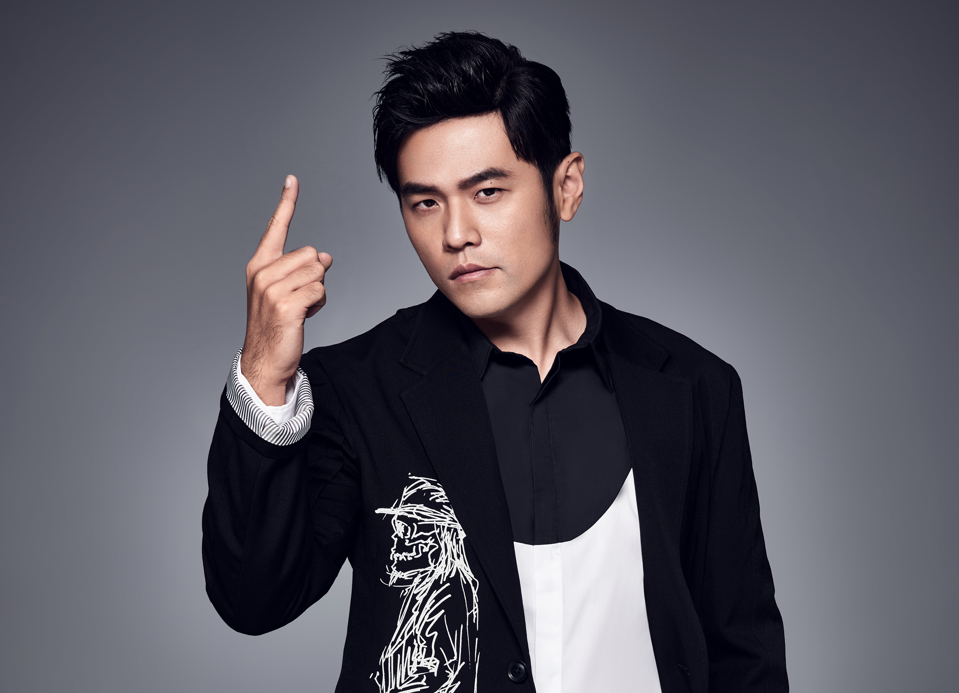
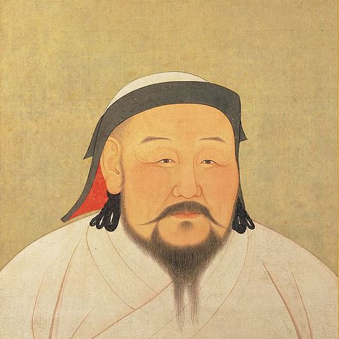
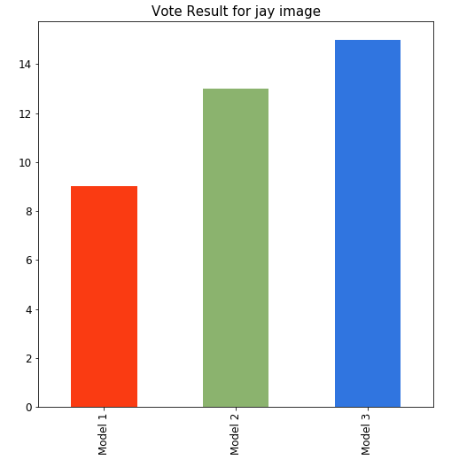
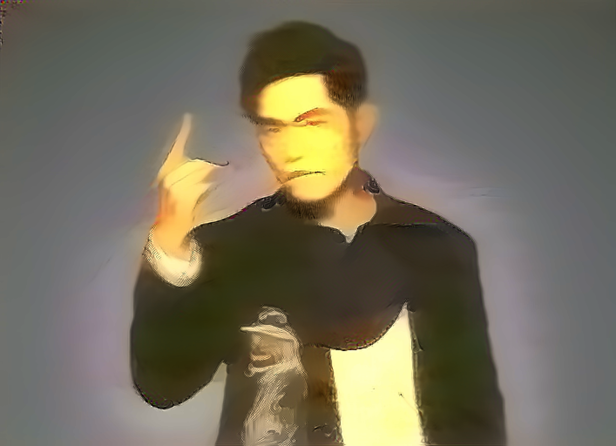
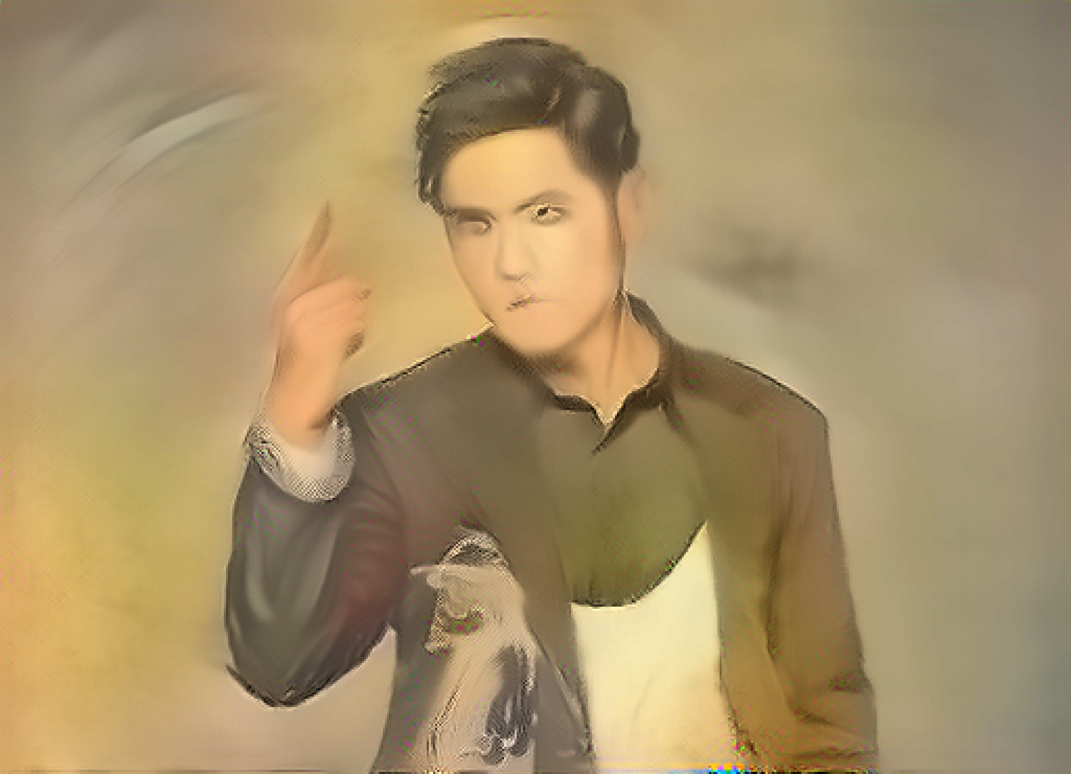
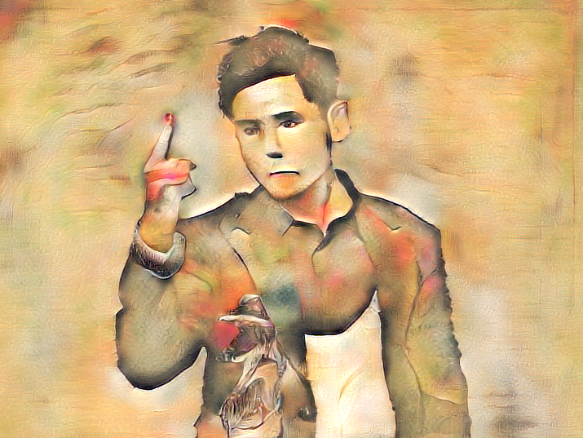
EVALUATION
Content Image
Style Image
Model 1
Model 2
Model 3
1
1
2

Slide 13
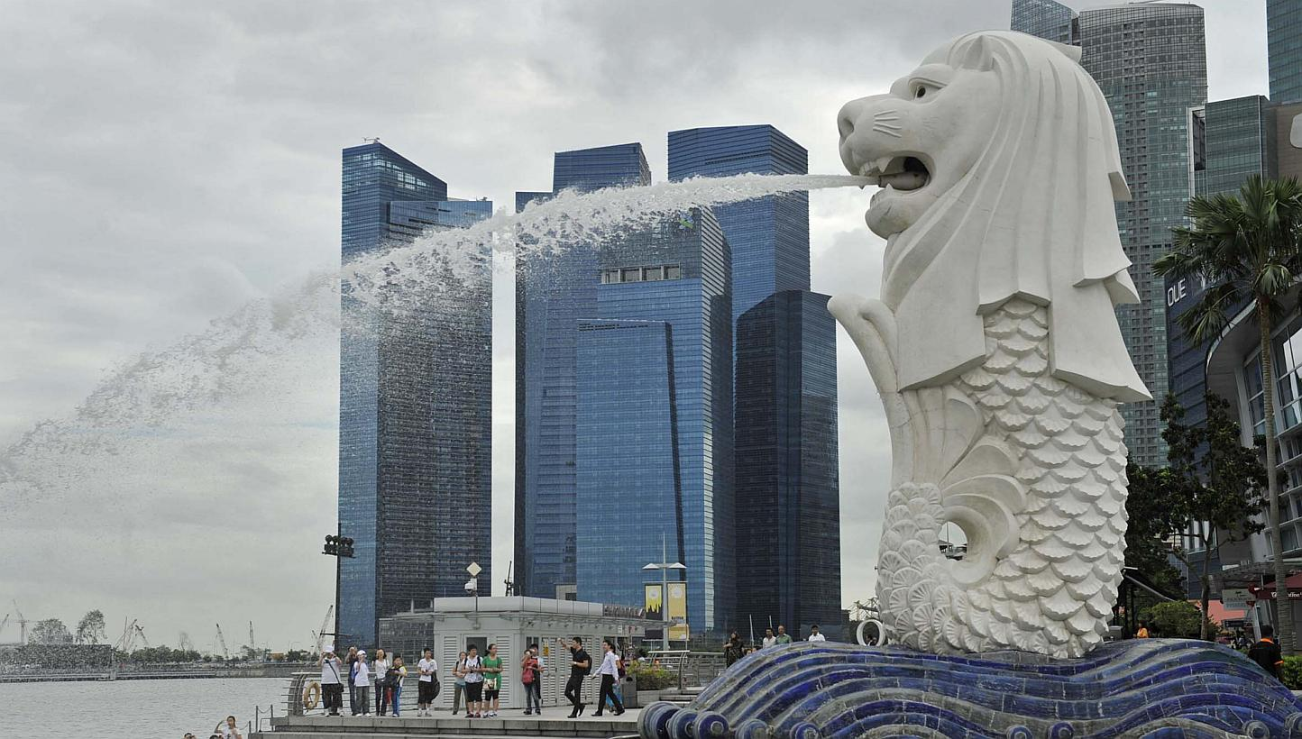
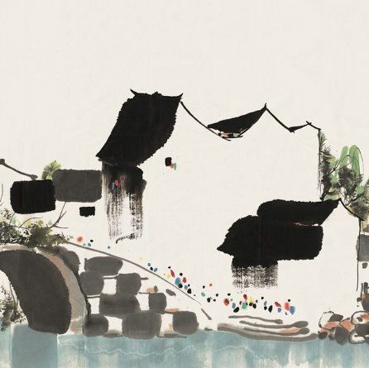
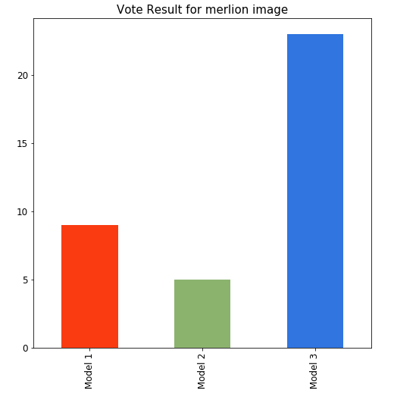
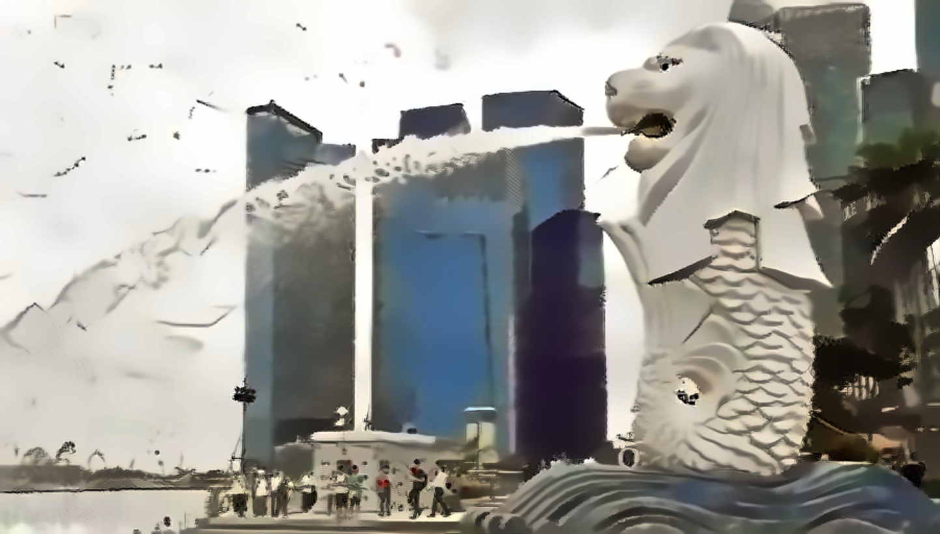
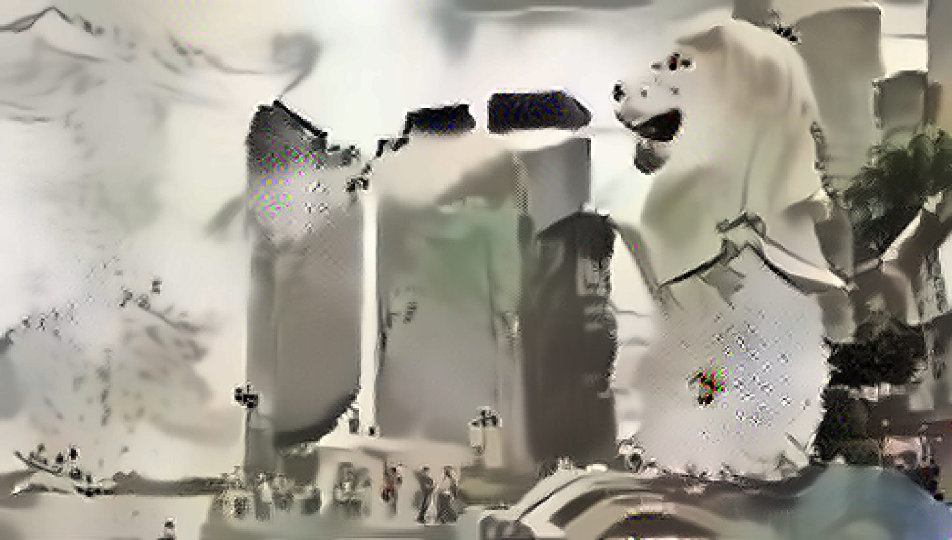
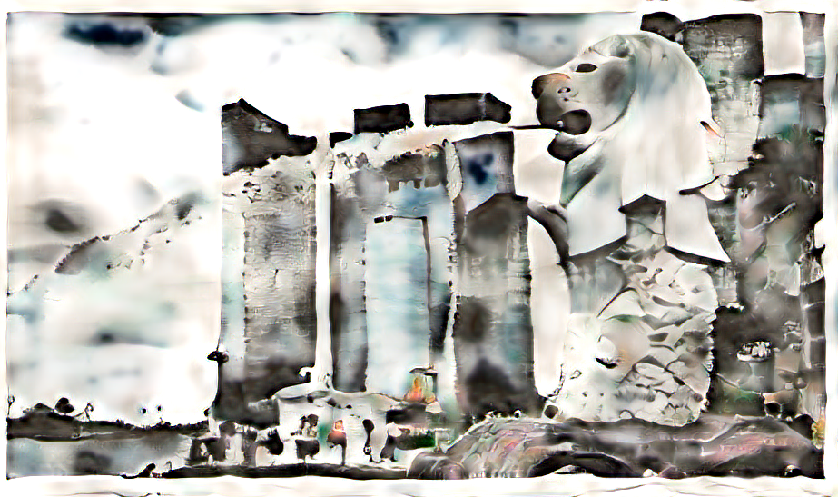
EVALUATION
Content Image
Style Image
Model 1
Model 2
Model 3
1
1
3

Slide 14
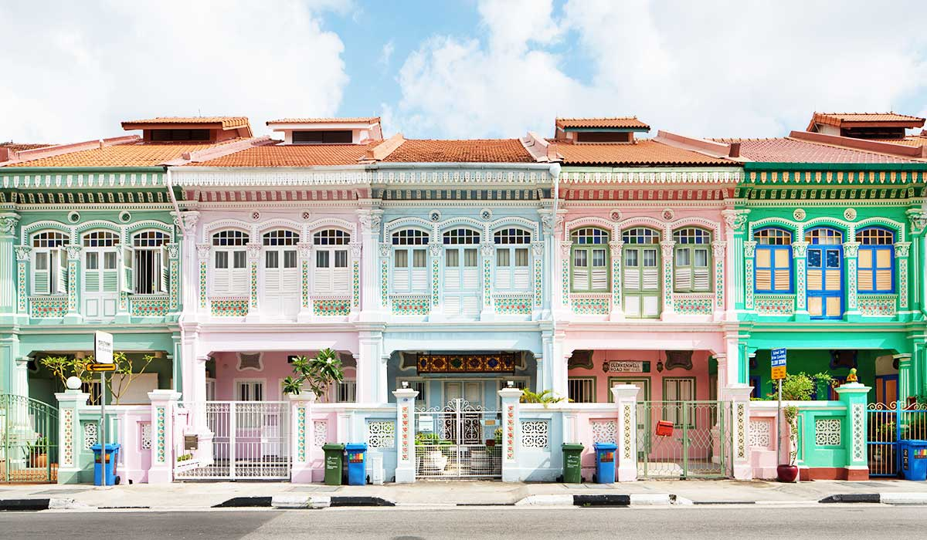
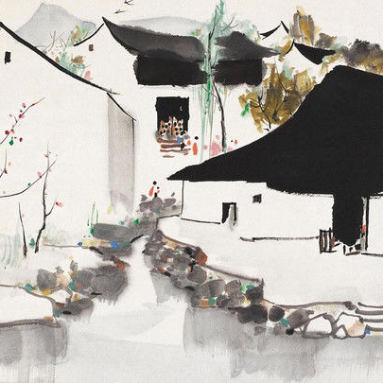
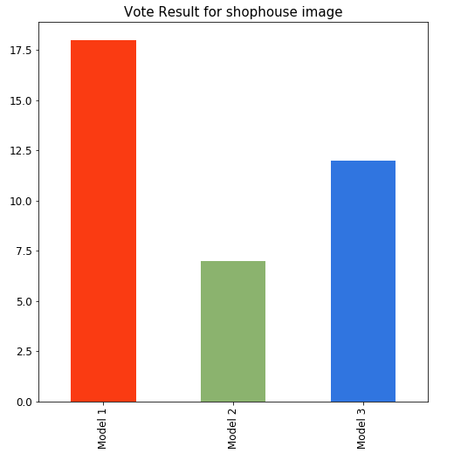
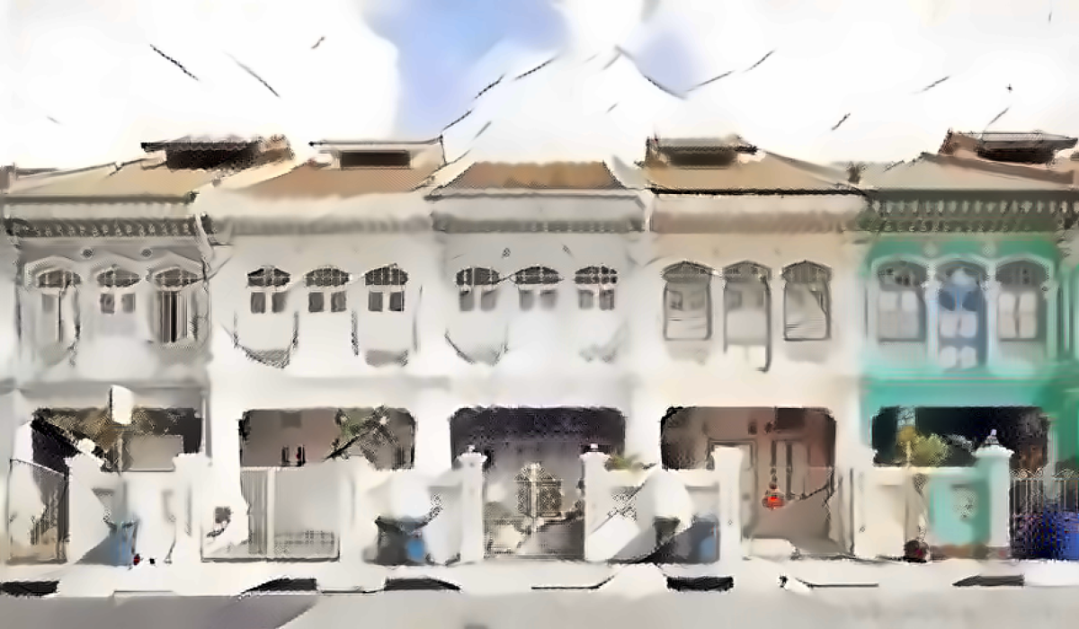
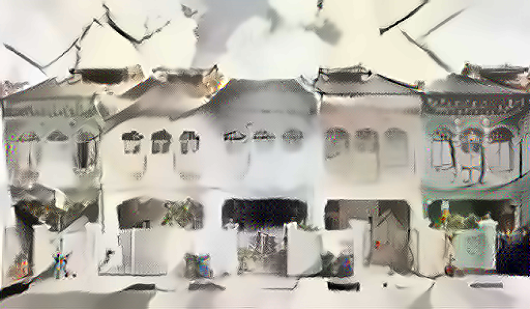
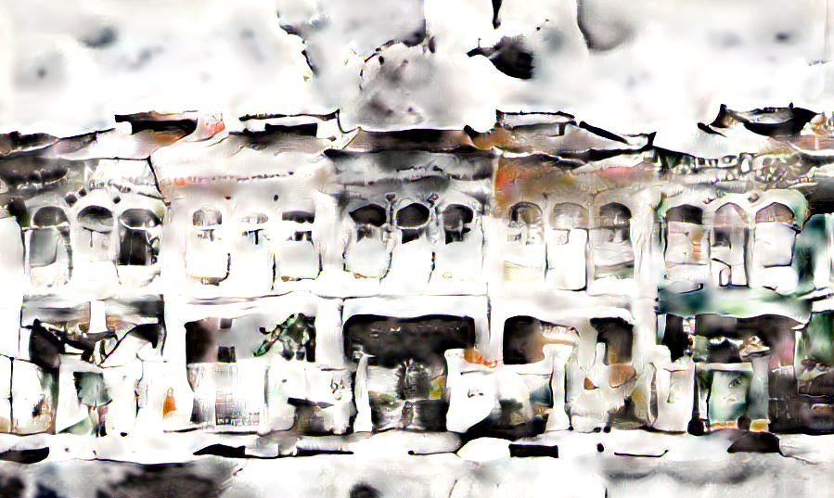
EVALUATION
Content Image
Style Image
Model 1
Model 2
Model 3
2
1
3

Slide 15
CONCLUSION
Model 1
Model 2
Model 3
2
1
3

Slide 16
RECOMMENDATIONS
Include more techniques to control the style transfer
Improve image resolutions for high quality printing
Optimise model for GPU
Real time NST for video/webcam

Slide 17
THANK YOU

